Slide 1
Universal Precautions

Slide 2
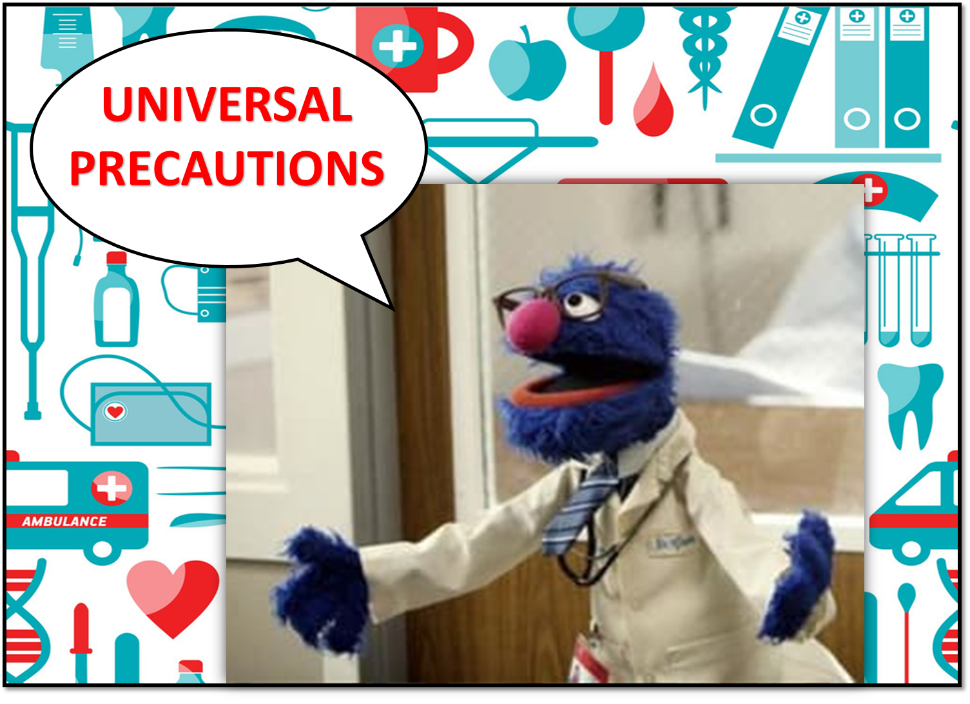

Slide 3
Training Objective
To obtain an understanding of what it is to promote health and safety of consumers , children in foster care, employees and foster parents.

Slide 4
Research
Research has shown that AIDS, HIV and HBV are blood borne diseases that are transmitted primarily through sexual contact or blood to blood contact.
It should be assumed that any person whether a child or an adult , can be a carrier of HIV, HBV or other blood borne pathogens

Slide 5
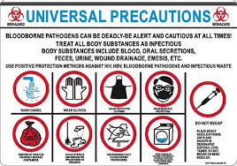
Universal Precautions
Definition
Assistance
Steps we should take to protect ourselves when we come in contact with the blood or bodily fluids of other people.
Universal Precautions are designed to stop the spread of germs and viruses to others.
Childkind recommends that all foster parents / care givers obtain appropriate protective equipment such as disposable gloves, masks and other barriers and equipment.
Should you need assistance please ask you nurse or FSC.

Slide 6
Universal Precautions Continued
Universal Precautions is one component of an infection control program. The CdC and American Hospital Association agree that universal precautions represents the best means of protection against the transmission of HIV, HBV, and other blood borne pathogens.

Slide 7
Most of the time you can not tell if a person is infected with Aids, Hepatitis B & C, or any number of other diseases. The best thing to do is to treat the blood and other bodily fluids of every person as potentially infectious. That includes Semen, blood, and viginal secreations.
https://www.youtube.com/watch?v=vVIte0uRBnw

Slide 8
The Basics of universal precautions
Blood and bodily fluids
Gloves
Clean up spills promptly using absorbent material first, and then clean more thoroughly with disinfectant like household bleach.
Wear latex , vinyl or rubber disposable gloves when handling blood or bodily fluids, or when cleaning cuts, scrapes or wounds.
Add cloves to your first Aid kits so they are always ready.
Disposed of used gloves or gloves that are cracked, tore or discolored

Slide 9
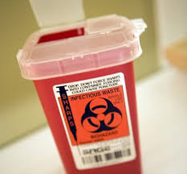
The basics cont.
Needle Stick injuries
Sharp objects
If possible put the pricked area low to the ground to promote bleeding . Wash the area well with soap and water. Call or visit the nearest local clinic hospital emergency department immediately for treatment.
Place needles and syringes in a safe container. Never bend or break used needles.
Place them in a sealed, puncture proof metal or plastic container with a lid.
Place the container in the trash.

Slide 10
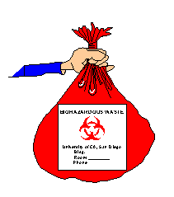
Basics
Personal Articles
Laundry
Never allow anyone to share toothbrushes or razors. small amounts of blood can be transmitted from one person to another. Wrap sanitary napkins before disposing . Handle blood bedding or clothing cautiously and wash with hot soapy water.
Linens and clothing that are soiled with blood or other bodily fluids should be placed in bags or containers that prevent leakage until they can be laundered. These items should be washed separately form other items.

Slide 11
Hand washing Always Wash hands
Thoroughly with soap and water for 15 to 20 seconds
After cleaning the restroom
Before a break
After using the restroom
Before and after providing first aid
After handling blood and body fluids

Slide 12
Keeping yourself Safe
Childkind prefers that you always wear gloves. Remember it is always important to wash your hands carefully after touching any bodily fluids, even if you have worn gloves
You can make up a bleach solution for a small job wit a tablespoon of bleach and a quart of water.
Be sure to keep bleach away from children , store in a locked closet.

Slide 13
